Slide 1

Chore Contest Program
A program to allow households to easily run a chore contest.
By: Michelle Fields

Slide 2
What was the idea?
Original: a two-part program to hold a chore contest.
Part 1: gather data & print rankings
Part 2: prize pool
Reality: a simple program to gather data & print total chores completed
Code source: https://github.com/ksu-is/bingocaller
Didn’t end up using much from that

Slide 3
Surprises & changes
Surprises:
Amount of coding required
Difficulty making ranks
Changes:
Simple program – just gathers data
No ranking
No prize pool

Slide 4
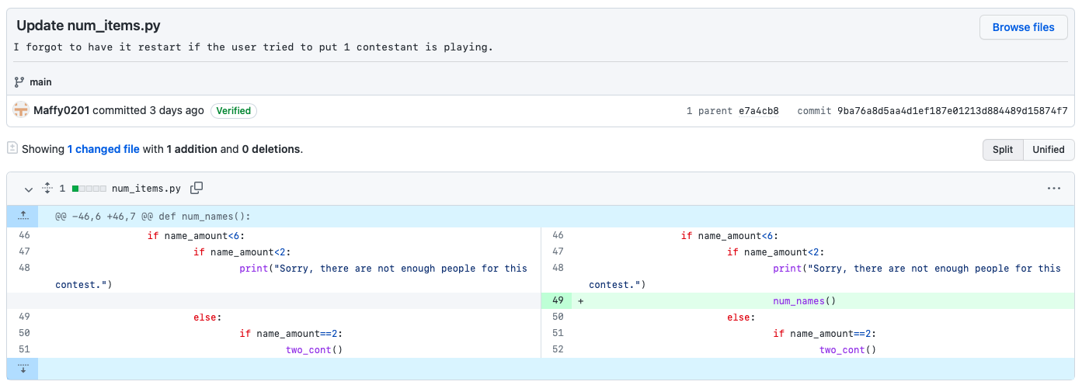
Roadblocks
Forgetting small things (i.e., restart a function if input is invalid)

Slide 5
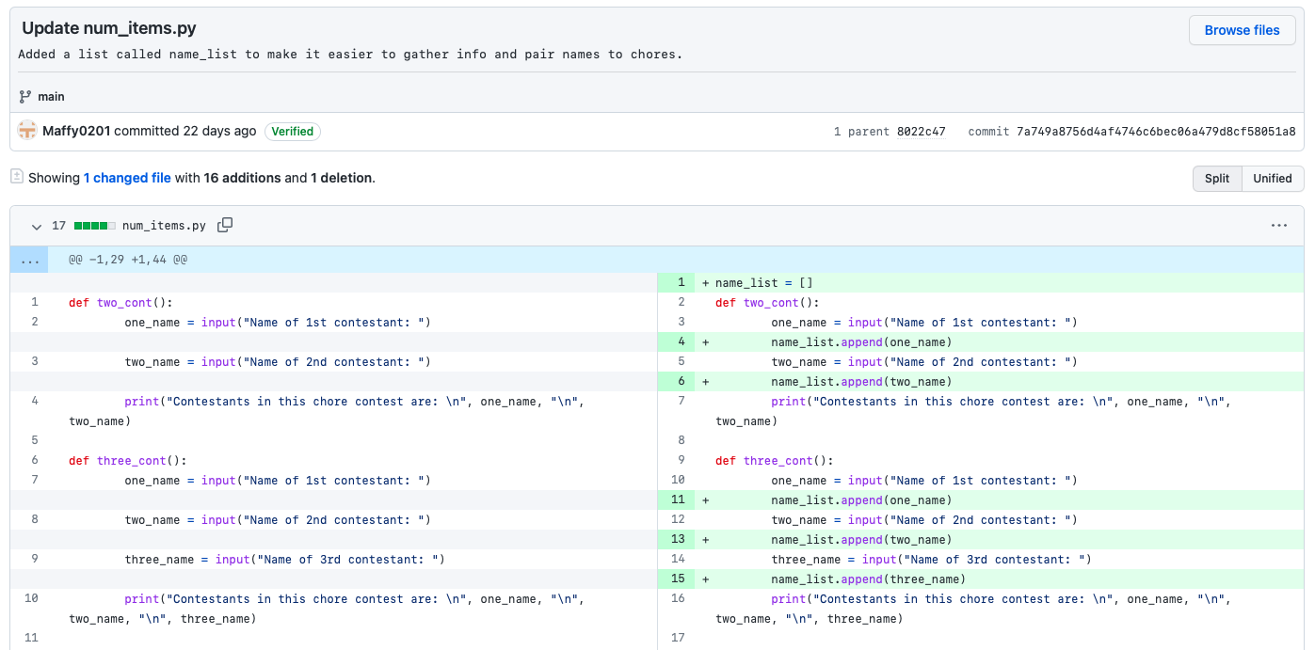
More roadblocks
Getting input to match up & be usable

Slide 6
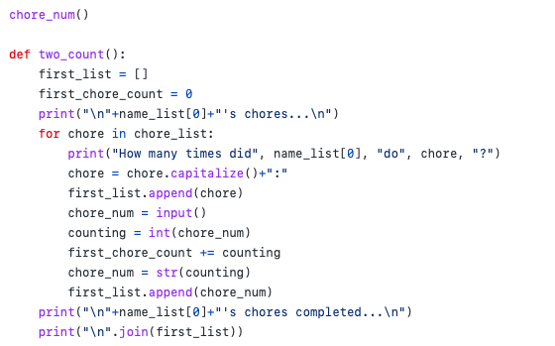
And more roadblocks
Requesting more user input & matching it up

Slide 7
Chore contest code

Slide 8
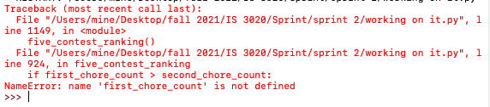
Does it run?
It runs but without many of the desired functions.
The program lacks:
Ranking system
Pool of names
Selection from prize pool

Slide 9
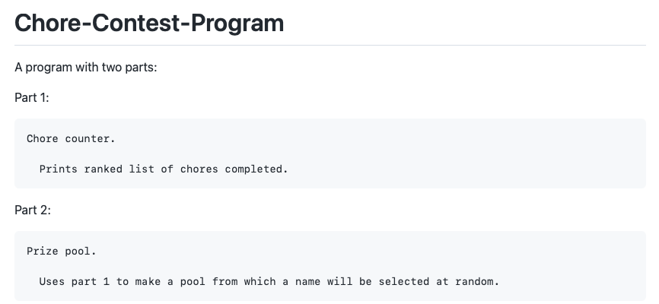
Next…
Make ranking system work
Attempt part 2

